Slide 1
A2L: Anonymous Atomic Locks for Scalability and Interoperability in Payment-Channel Hubs
S&P 2021
Erkan Tairi TU Wien
Pedro Moreno-Sanchez IMDEA Software Institute
Matteo Maffei TU Wien
Notes:
具有可扩展性和互操作性的匿名原子锁

Slide 2
Abstract
PCH Definition:
Payment channel hubs (PCHs) constitute a promising solution to the inherent scalability problem of blockchain technologies, allowing for off-chain payments between sender and receiver through an intermediary, called the tumbler.
Problem：
The state-of-the-art PCHs relies on the scripting-based functionality available only at few cryptocurrencies, and they thus fall short of fundamental properties such as backwards compatibility and efficiency.
This work (A2L)：
Provide security and privacy PCH
Backwards compatible
Requiring only digital signatures and timelock functionality
Prove under Universal Composability framework
Better performance

Slide 3
Outline
Background
Preliminaries
Randomizable Puzzle
Proposal
Performance Analysis
ESORICS22 Proposal

Slide 4
1. Background

Slide 5
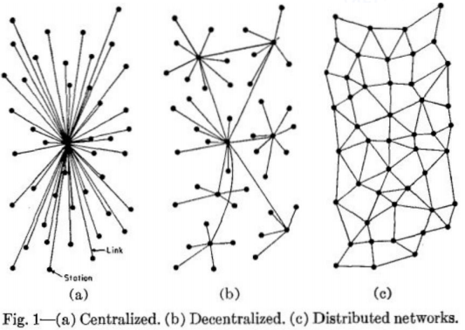
PCN vs PCH
PCN Limitation:
PCN payment requires sequential channel updates from sender to receiver, breaking unlinkability when there is a single intermediary
PCNs raise the issue of finding paths in a network and maintaining the network topology
Tumbler
/Mixer
PC Hubs (PCH)
PC Networks (PCN)

Slide 6
Challenges in blockchain: a path towards PCH
Unlinkability: None (including the mixer) can determine which sender paid to which receiver.
Atomicity: Mixers is not necessarily honest. Either a payment is successful or the money goes back to the sender.
Interoperability: Support transactions across the chain.
Scalability: Transaction throughput problem. PCHs supports off-chain payments that each party opens a channel with a tumbler.

Slide 7
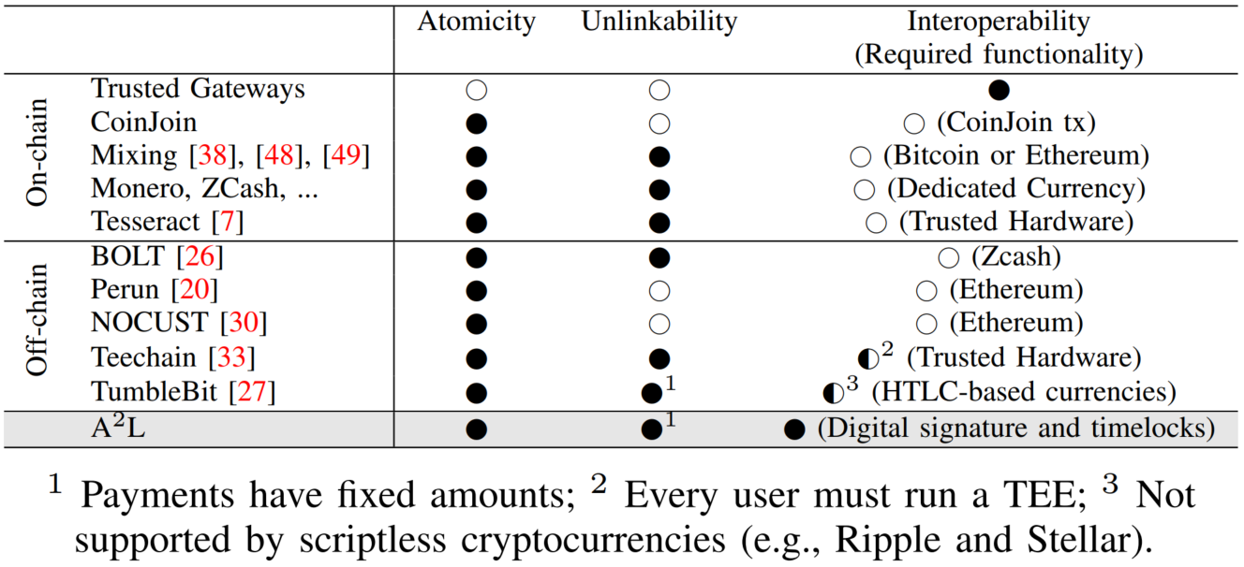
Related Work and Problem Statement
Is it possible to design a PCH that provides atomicity, unlinkability, and interoperability (i.e., it is based on few assumptions that are fulfilled by virtually all cryptocurrencies)

Slide 8
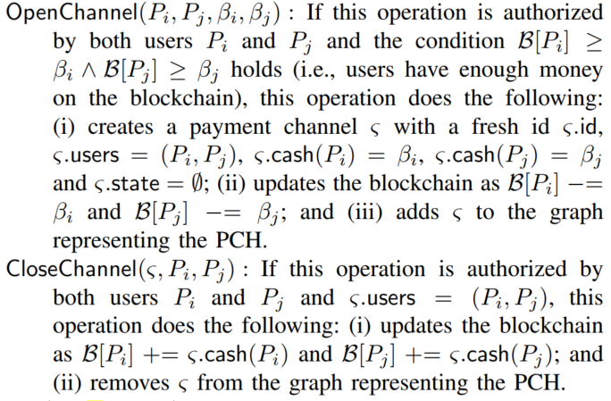
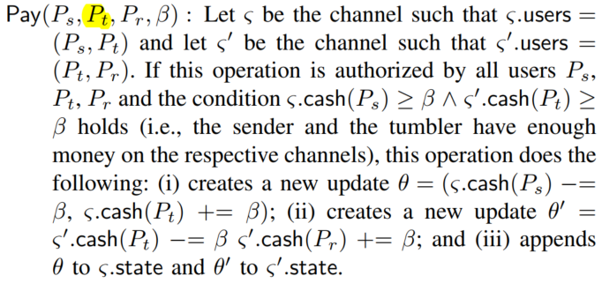
PCH Functionality

Slide 9
PCH Security and Privacy Goals
Authenticity: The PCH should only start a payment procedure if the sender Ps has been successfully registered by the tumbler Pt.
Atomicity: The PCH should not be exploited to print new money or steal existing money from honest users, even when parties collude.
Unlinkability: The tumbler Pt should not learn information that allows it to associate the sender Ps and the receiver Pr of a payment.

Slide 10



Griefing Attack
Receiver
Sender
$
Mixer
$
$
$
$
$$$$
Lock
$

Slide 11
Contributions
We introduce A2L.
Instantiation: Schnorr and ECDSA
Script: scriptless script but not HTLCs
Interoperability: as a classic onchain tumbler, including offchain operations as on-chain transactions.
We propose a the novel concept of randomizable puzzle.
We model A2L in the UC framework.
Our evaluation shows that A2L is better than TumbleBit.

Slide 12
2. Preliminaries

Slide 13
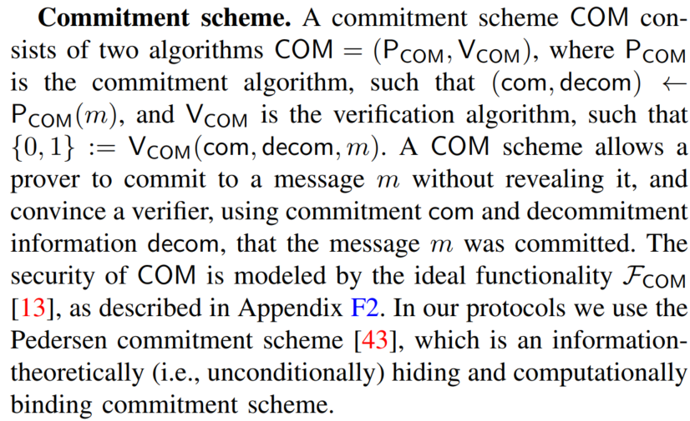
Commitment scheme

Slide 14
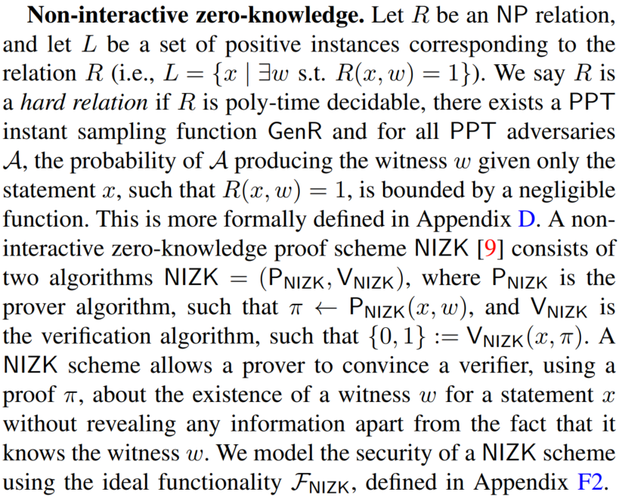
NIZK

Slide 15
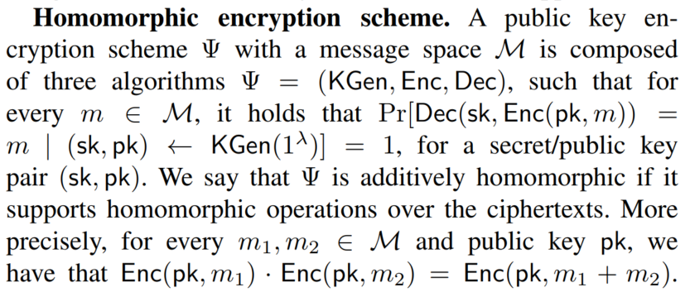
Homomorphic encryption scheme

Slide 16
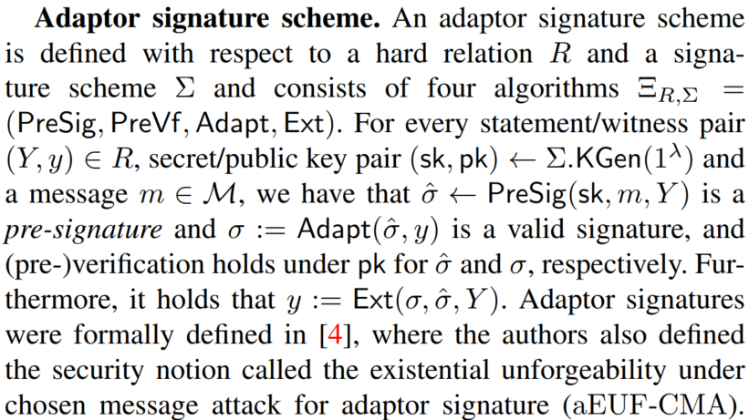
Adaptor signature scheme

Slide 17
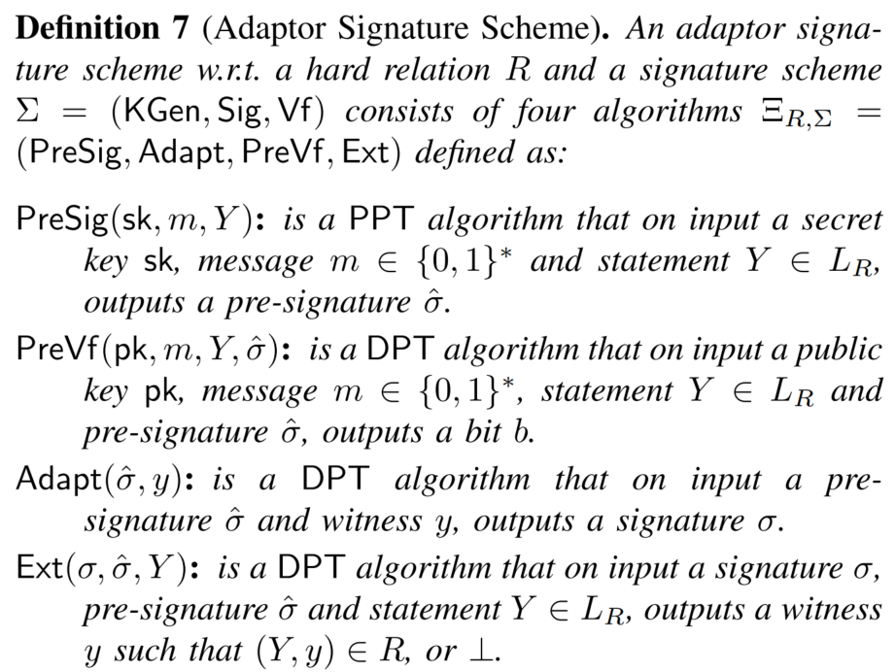
Adaptor signature scheme

Slide 18
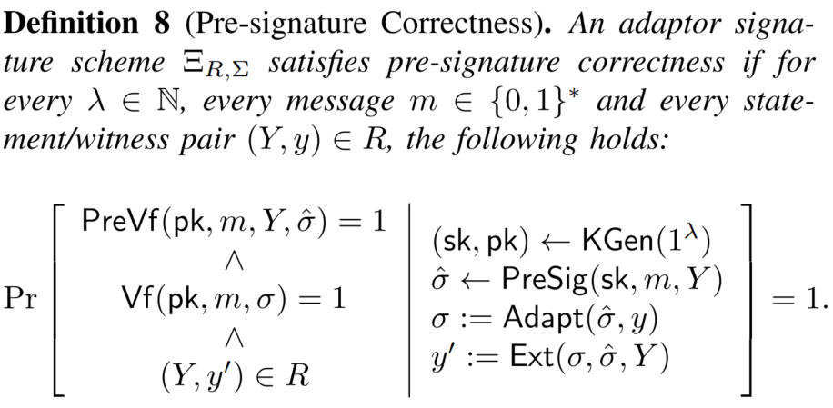
Adaptor signature scheme

Slide 19
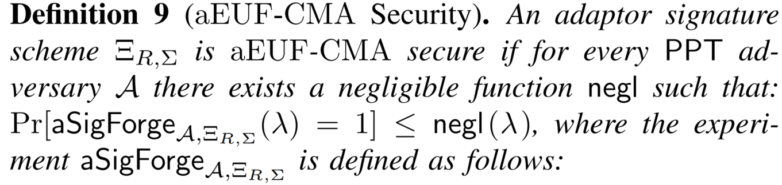
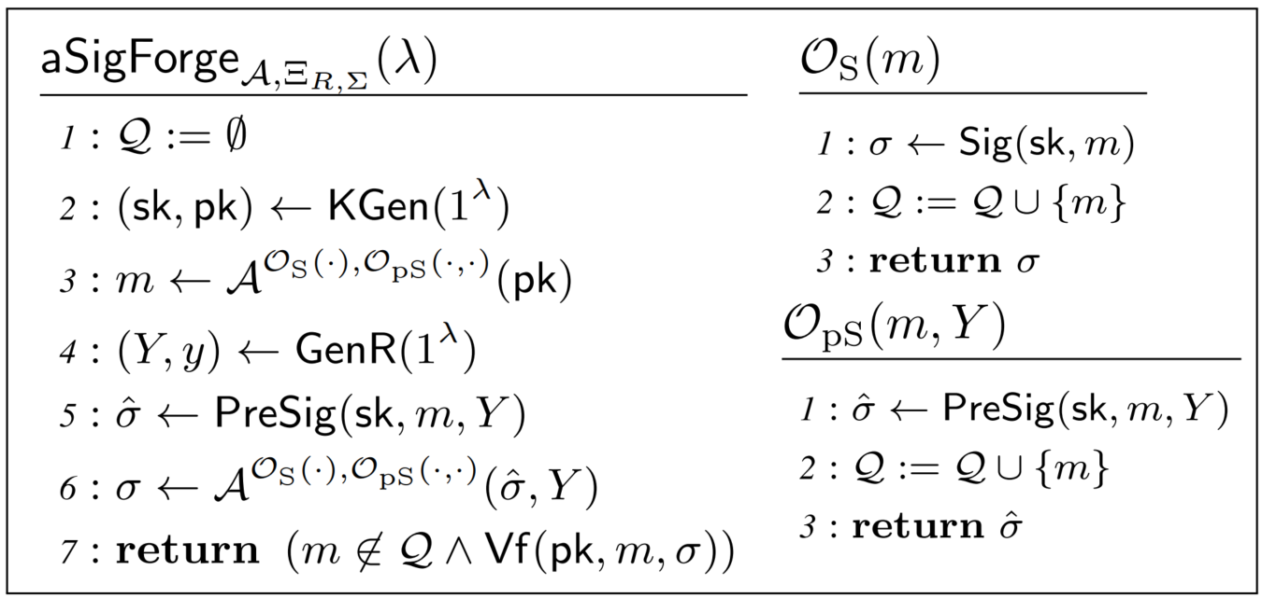
Adaptor signature scheme

Slide 20
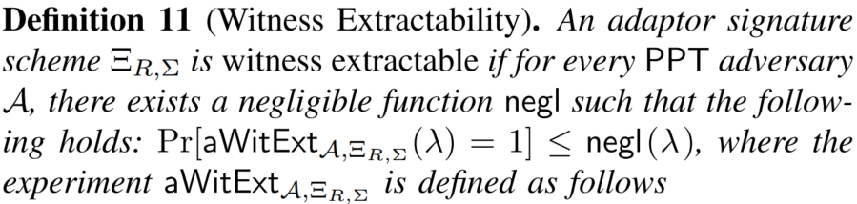
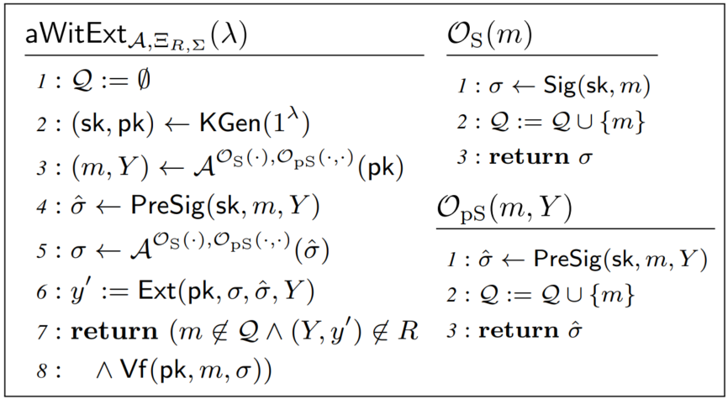
Adaptor signature scheme

Slide 21
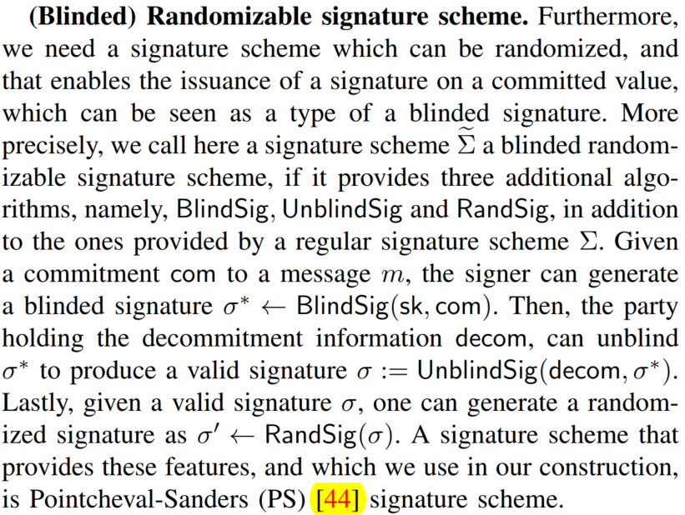
Randomizable Signature Scheme

Slide 22
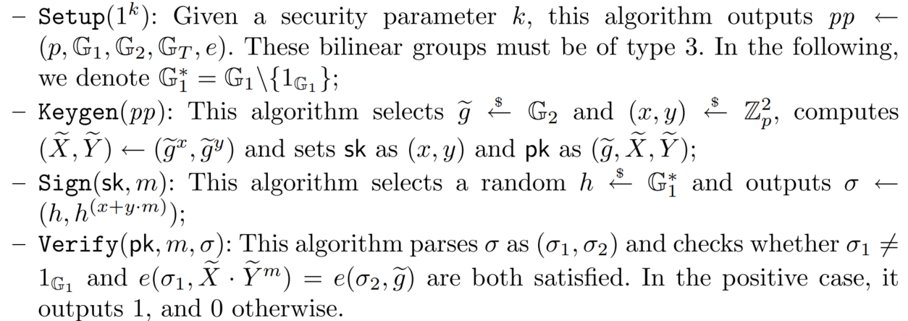
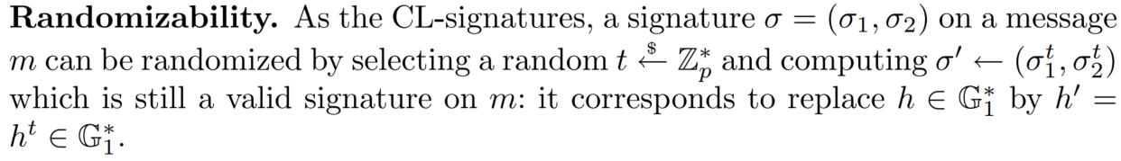
Randomizable Signature Scheme - CT-RSA 2016 [44]

Slide 23
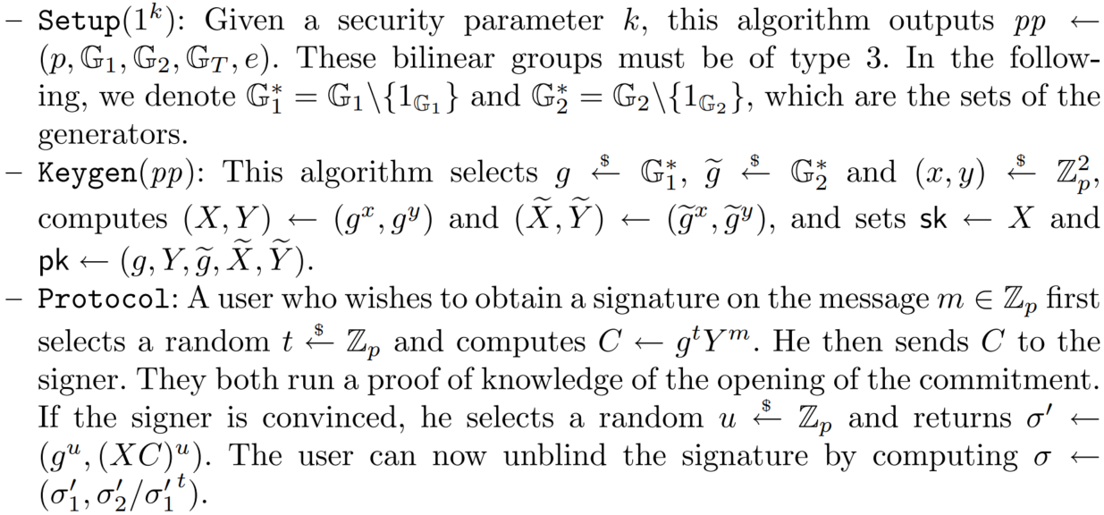
（Blinded）Randomizable Signature Scheme - [44]

Slide 24
3. Randomizable Puzzle

Slide 25
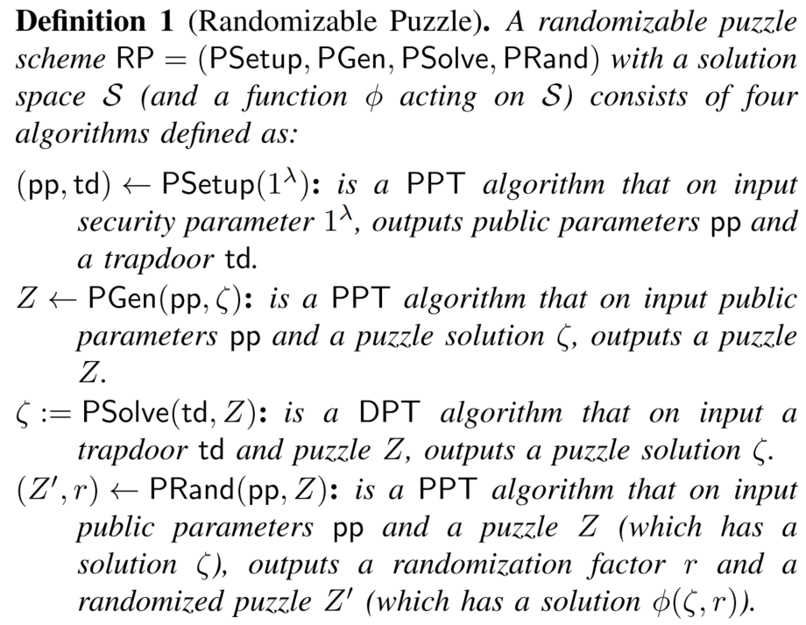
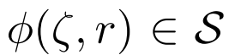
Randomizable Puzzle
Notes:
zite

Slide 26
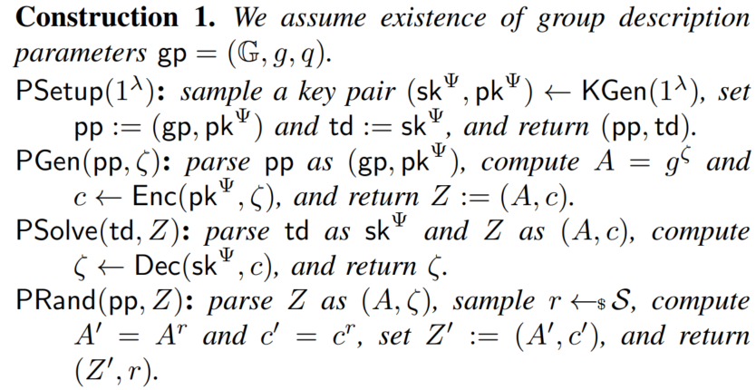
Randomizable Puzzle Construction
Homomorphic encryption(IND-CPA)

Slide 27
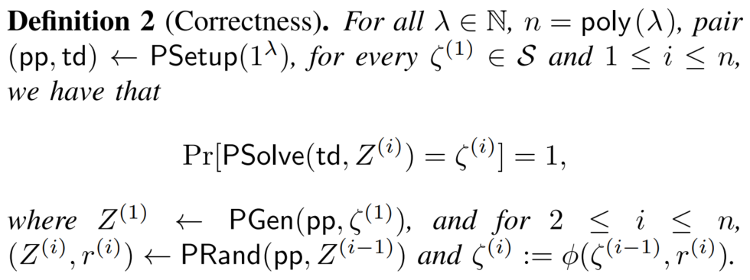
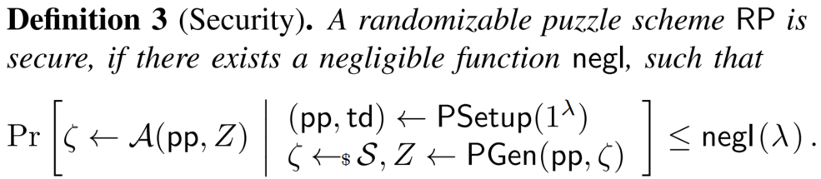
Randomizable Puzzle

Slide 28
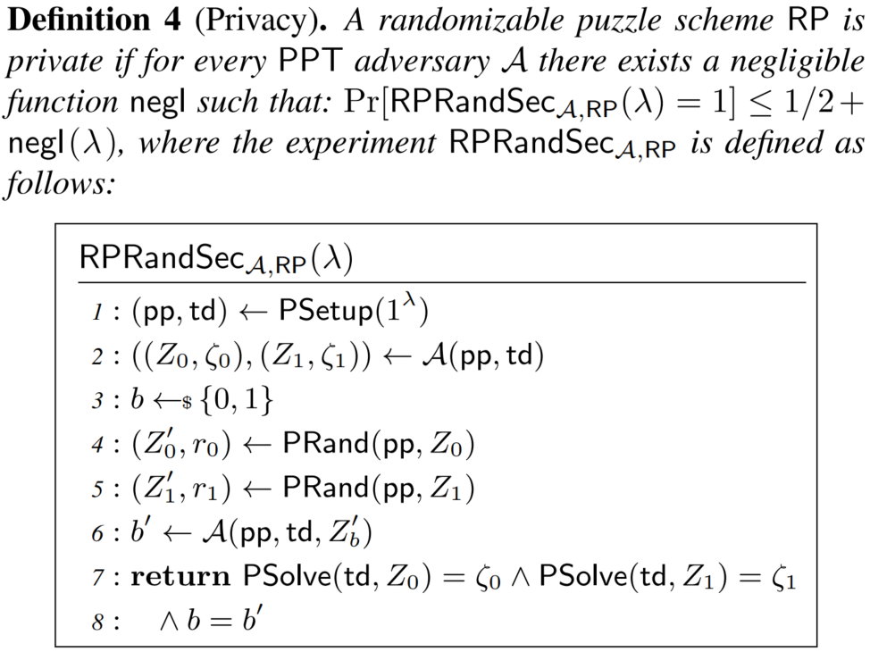
Randomizable Puzzle

Slide 29
4. Proposal

Slide 30
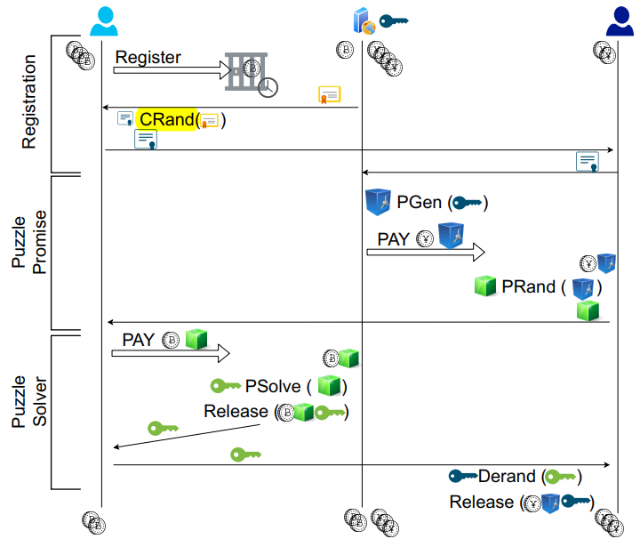
Overview

Slide 31
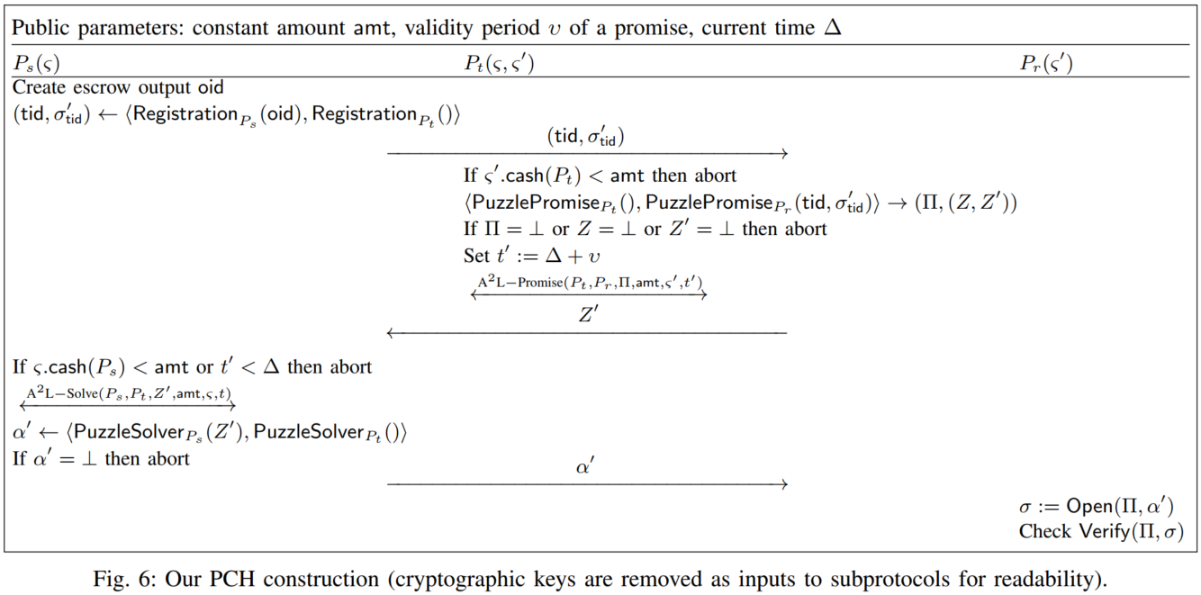
Overview

Slide 32
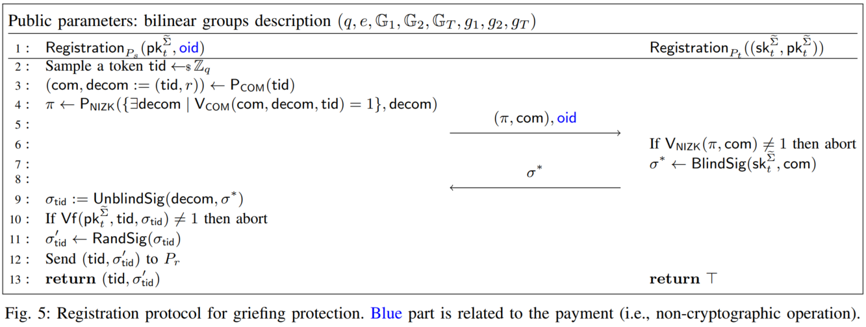
Registration

Slide 33
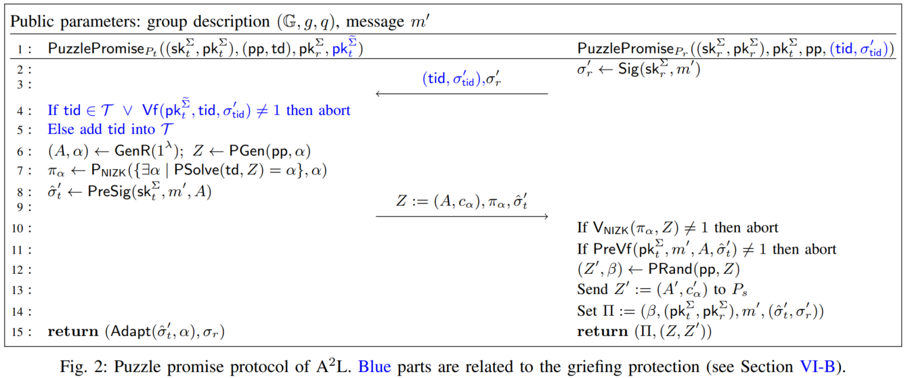
Puzzle promise

Slide 34
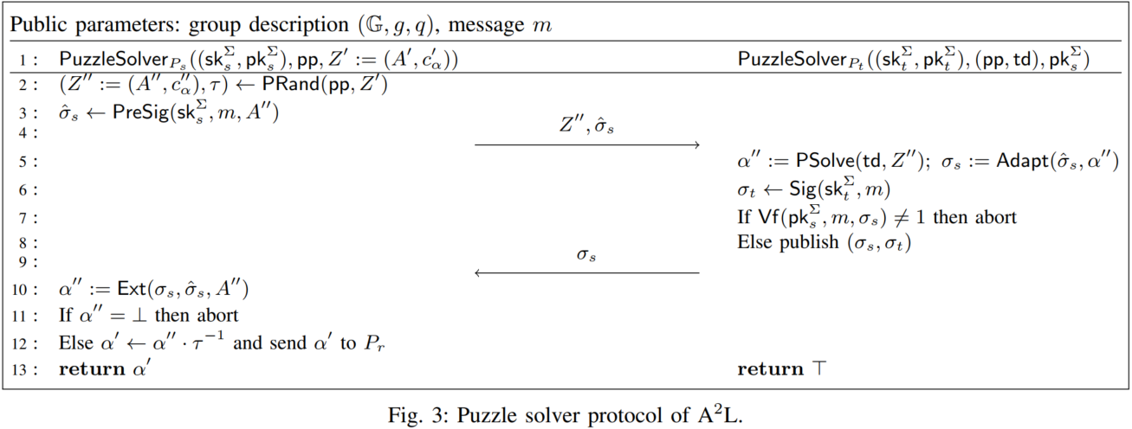
Puzzle solver

Slide 35
Instantiation
Schnorr-based Construction
ECDSA-based Construction

Slide 36
5. Performance Analysis

Slide 37
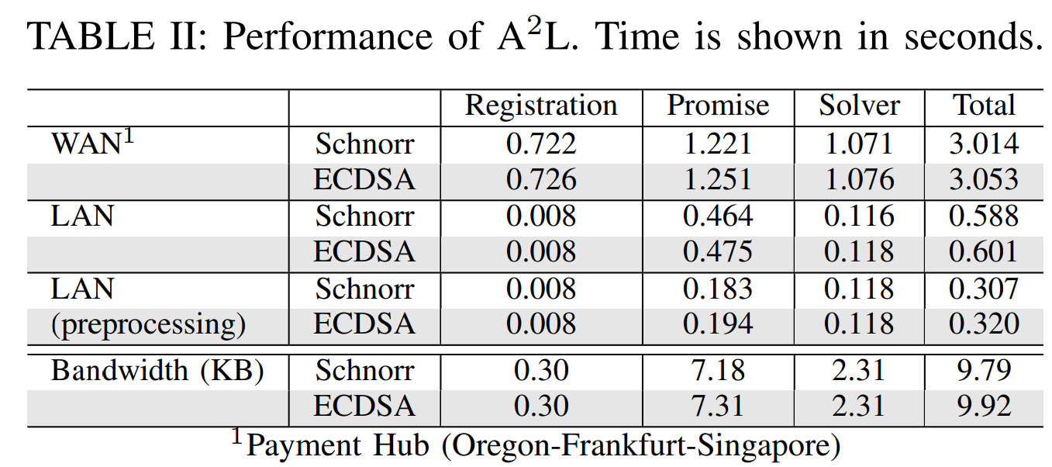
Performance

Slide 38
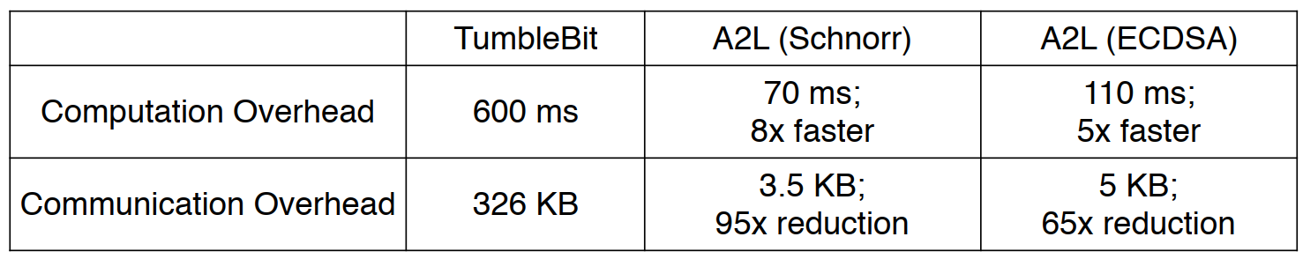
Comparison with TumbleBit

Slide 39
6. ESORICS22 Proposal

Slide 40
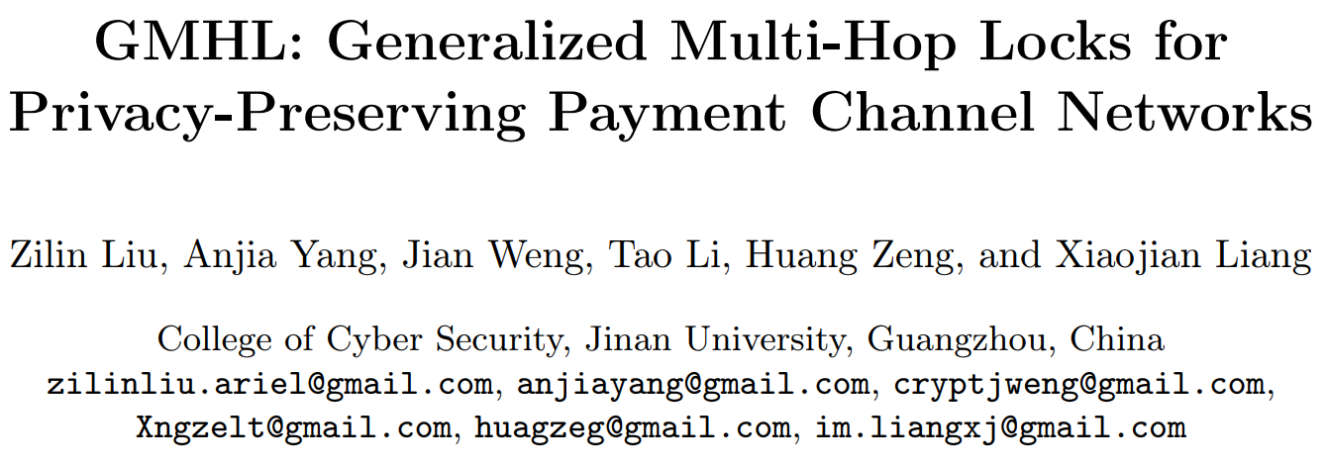
ESORICS22

Slide 41
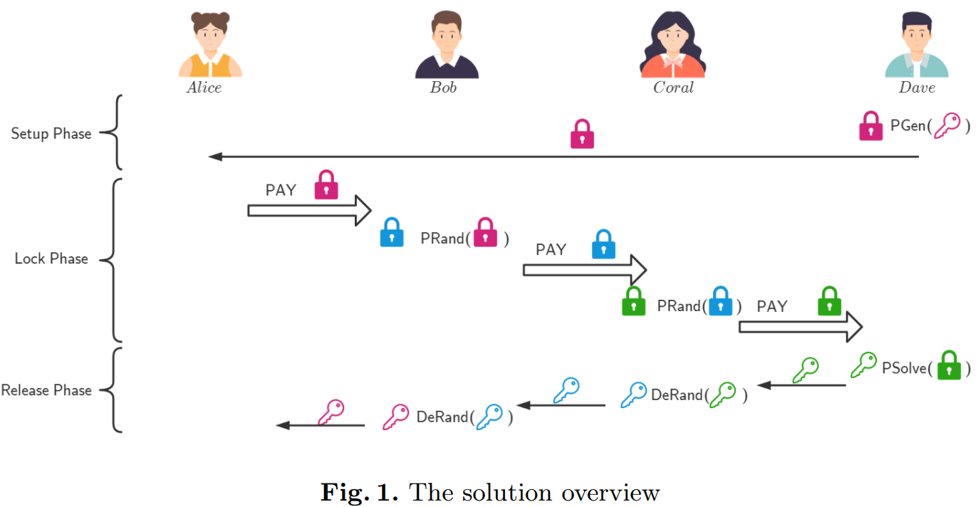
ESORICS22

Slide 42
Future works
Any amounts
New attacks
Multiple mixers
Reused setup
Reduce the number of round

Slide 43
THANK YOU!

